Slide 1
Vaccinated susceptibles are able to get infected
Parameter | Description
r_{x} | Rate of Vaccination in subpopulation x
β_{xy} | Per capita rate of transmission from infectious subpopulation y to susceptible subpopulation x
γ | Per capita rate of recovery
σ₁ | Per capita rate of immunity loss (both vaccinated or naturally infected)
σ₂ | Per capita rate of immunity loss (for those who have been infected/recovered and vaccinated)
e_{ff1} | Vaccine Efficacy (preventing infection)
e_{ff2} | Vaccine Efficacy (preventing onwards infectiousness)
V_{i}
β_{xx}
Vi_{i}
γ
Vr_{i}
σ₂
σ₁
Example sub-population i
S_{i}
β_{xx}
I_{i}
γ
R_{i}
r_{i}
σ₁
r_{i}
Rv_{i}
r_{i}
σ₂
Compartment | Description (Proportion of population in…)
S_{x} | Susceptibles in subpopulation x
I_{x} | Infectious individuals in subpopulation x
R_{x} | Recovered individuals in subpopulation x
Rv_{x} | Recovered or Infectious and subsequently vaccinated in subpopulation x
V_{x} | Vaccinated individuals in subpopulation x
Vi_{x} | Vaccinated and infectious individuals in subpopulation x
Vr_{x} | Vaccinated and recovered individuals in subpopulation x
Example Transmission Route – Infection from subpop j to i
To/From
Susceptible (S_{i})
Vaccinated (V_{i})
β_{ij}I_{j}S_{i}
(1-e_{ff1})β_{ij}I_{j}V_{i}
Infected (I_{j})
S_{i}
I_{i}
V_{i}
Vi_{i}
Vaccinated but
Infected (Vi_{j})
(1-e_{ff2})β_{ij}Vi_{j}S_{i}
(1-e_{ff1})(1-e_{ff2})β_{ij}Vi_{j}V_{i}
S_{i}
I_{i}
V_{i}
Vi_{i}

Slide 2
Example equations sub-population i
$$\frac{dS_{i}}{dt}=σ1{(V}_{i}+R_{i})+σ2{(Rv}_{i}+{Vr}_{i}){−β}_{ii}S_{i}I_{i}−β_{ij}S_{i}I_{j}−β_{ik}S_{i}I_{k}−{\left(1−e_{ff2}\right)β}_{ii}S_{i}{Vi}_{i}−(1−e_{ff2})β_{ij}S_{i}{Vi}_{j}−(1−e_{ff2})β_{ik}S_{i}{Vi}_{k}−r_{i}S_{i}$$
$$\frac{dI_{i}}{dt}=β_{ii}S_{i}I_{i}+β_{ij}S_{i}I_{j}+β_{ik}S_{i}I_{k}+{\left(1−e_{ff2}\right)β}_{ii}S_{i}{Vi}_{i}+\left(1−e_{ff2}\right)β_{ij}S_{i}{Vi}_{j}+\left(1−e_{ff2}\right)β_{ik}S_{i}{Vi}_{k}−γI_{i}−r_{i}I_{i}$$
$$\frac{dR_{i}}{dt}=γI_{i}−r_{i}R_{i}−σ_{1}R_{i}$$
$$\frac{d{Rv}_{i}}{dt}=r_{i}\left(I_{i}+R_{i}\right)−σ_{2}{Rv}_{i}$$
$$\frac{dV_{i}}{dt}=r_{i}S_{i}−{\left(1−e_{ff1}\right)β}_{ii}V_{i}I_{i}−{\left(1−e_{ff1}\right)β}_{ij}V_{i}I_{j}−{\left(1−e_{ff1}\right)β}_{ik}V_{i}I_{k}−\left(1−e_{ff1}\right) {\left(1−e_{ff2}\right)β}_{ii}V_{i}{Vi}_{i}−\left(1−e_{ff1}\right)\left(1−e_{ff2}\right)β_{ij}V_{i}{Vi}_{j}−\left(1−e_{ff1}\right)\left(1−e_{ff2}\right)β_{ik}V_{i}{Vi}_{k}−σ_{1}V_{i}$$
$$\frac{d{Vi}_{i}}{dt}={\left(1−e_{ff1}\right)β}_{ii}V_{i}I_{i}+{\left(1−e_{ff1}\right)β}_{ij}V_{i}I_{j}+{\left(1−e_{ff1}\right)β}_{ik}V_{i}I_{k}+\left(1−e_{ff1}\right) {\left(1−e_{ff2}\right)β}_{ii}V_{i}{Vi}_{i}+\left(1−e_{ff1}\right)\left(1−e_{ff2}\right)β_{ij}V_{i}{Vi}_{j}+\left(1−e_{ff1}\right)\left(1−e_{ff2}\right)β_{ik}V_{i}{Vi}_{k}−γ{Vi}_{i}$$
$$\frac{d{Vr}_{i}}{dt}=γ{Vi}_{i}−σ_{2}{Vr}_{i}$$
Parameter | Description
r_{x} | Rate of Vaccination in subpopulation x
β_{xy} | Per capita rate of transmission from infectious subpopulation y to susceptible subpopulation x
γ | Per capita rate of recovery
σ₁ | Per capita rate of immunity loss (both vaccinated or naturally infected)
σ₂ | Per capita rate of immunity loss (for those who have been infected/recovered and vaccinated)
e_{ff1} | Vaccine Efficacy (preventing infection)
e_{ff2} | Vaccine Efficacy (preventing onwards infectiousness)
Compartment | Description (Proportion of population in…)
S_{x} | Susceptibles in subpopulation x
I_{x} | Infectious individuals in subpopulation x
R_{x} | Recovered individuals in subpopulation x
Rv_{x} | Recovered or Infectious and subsequently vaccinated in subpopulation x
V_{x} | Vaccinated individuals in subpopulation x
Vi_{x} | Vaccinated and infectious individuals in subpopulation x
Vr_{x} | Vaccinated and recovered individuals in subpopulation x

Slide 3
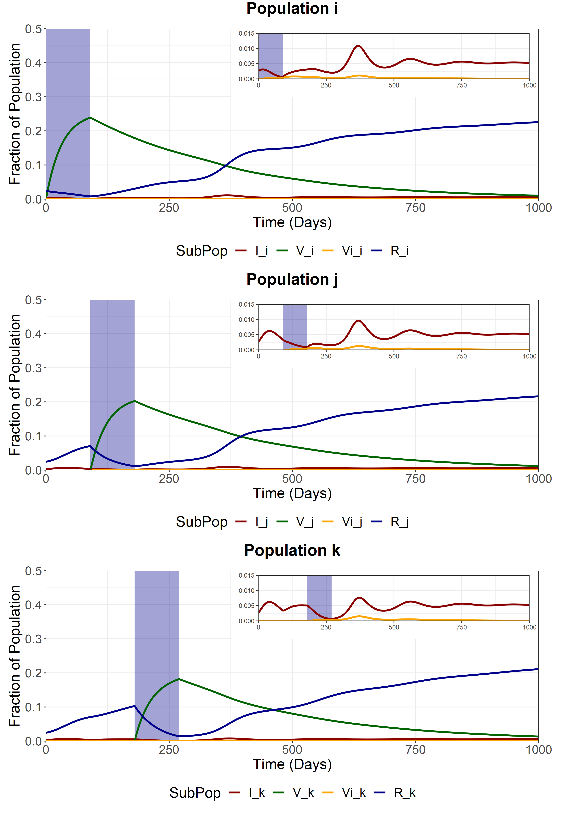
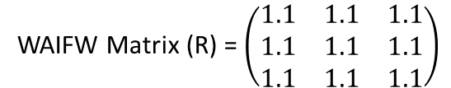
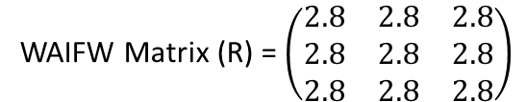
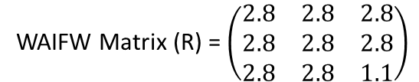
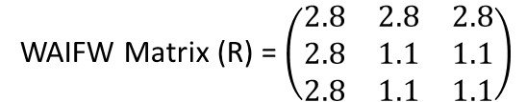
Scenario
We model sequential vaccination of 3 sub-populations. Each vaccination schedule lasts 90 days and aims for 90% coverage of the available susceptibles at the beginning of the simulation.
After vaccination of each subpopulation, the sub-population is released from NPIs, with the R increasing from 1.1 to 2.8.
We assume that 0.79% of the Scottish population is currently infected and 7.3% have already been infected and are now “Recovered”. Each subpopulation is proportionately the same size.
Vaccine efficacy is modelled at 90% (both eff1 and eff2) and coverage aims for 90% of the entire subpopulation
Subpopulation i
Target Coverage = 90%
Duration = 90 days
Trigger Date = day 0
Subpopulation j
Target Coverage = 90%
Duration = 90 days
Trigger Date = day 90
Subpopulation k
Target Coverage = 90%
Duration = 90 days
Trigger Date = day 180
Initial Conditions
S_{i} = 0.3064
S_{j} = 0.3064
S_{k} = 0.3064
I_{i} = 0.0071/3
I_{j} = 0.0071/3
I_{k} = 0.0071/3
V_{i} = 0
V_{j} = 0
V_{k} = 0
R_{i} = 0.073/3
R_{j} = 0.073/3
R_{k} = 0.073/3
WAIFW Matrix (R) = $\left(\begin{matrix}1.1 & 1.1 & 1.1 \\ 1.1 & 1.1 & 1.1 \\ 1.1 & 1.1 & 1.1\end{matrix}\right)$
During the pop i vaccination (t = 0-90)
The reason why the vaccinated compartment never reaches 0.29 (90-% of the population is due to the effects of vaccination infection and waning immunity.
Vaccinated individuals are constantly being depleted due to new infections and movement back to susceptibility.
WAIFW Matrix (R) = $\left(\begin{matrix}2.8 & 2.8 & 2.8 \\ 2.8 & 1.1 & 1.1 \\ 2.8 & 1.1 & 1.1\end{matrix}\right)$
During the pop j vaccination (t = 90-180)
WAIFW Matrix (R) = $\left(\begin{matrix}2.8 & 2.8 & 2.8 \\ 2.8 & 2.8 & 2.8 \\ 2.8 & 2.8 & 1.1\end{matrix}\right)$
During the pop k vaccination (t = 180-270)
WAIFW Matrix (R) = $\left(\begin{matrix}2.8 & 2.8 & 2.8 \\ 2.8 & 2.8 & 2.8 \\ 2.8 & 2.8 & 2.8\end{matrix}\right)$
After final vaccination schedule (t = 270-)

Slide 4
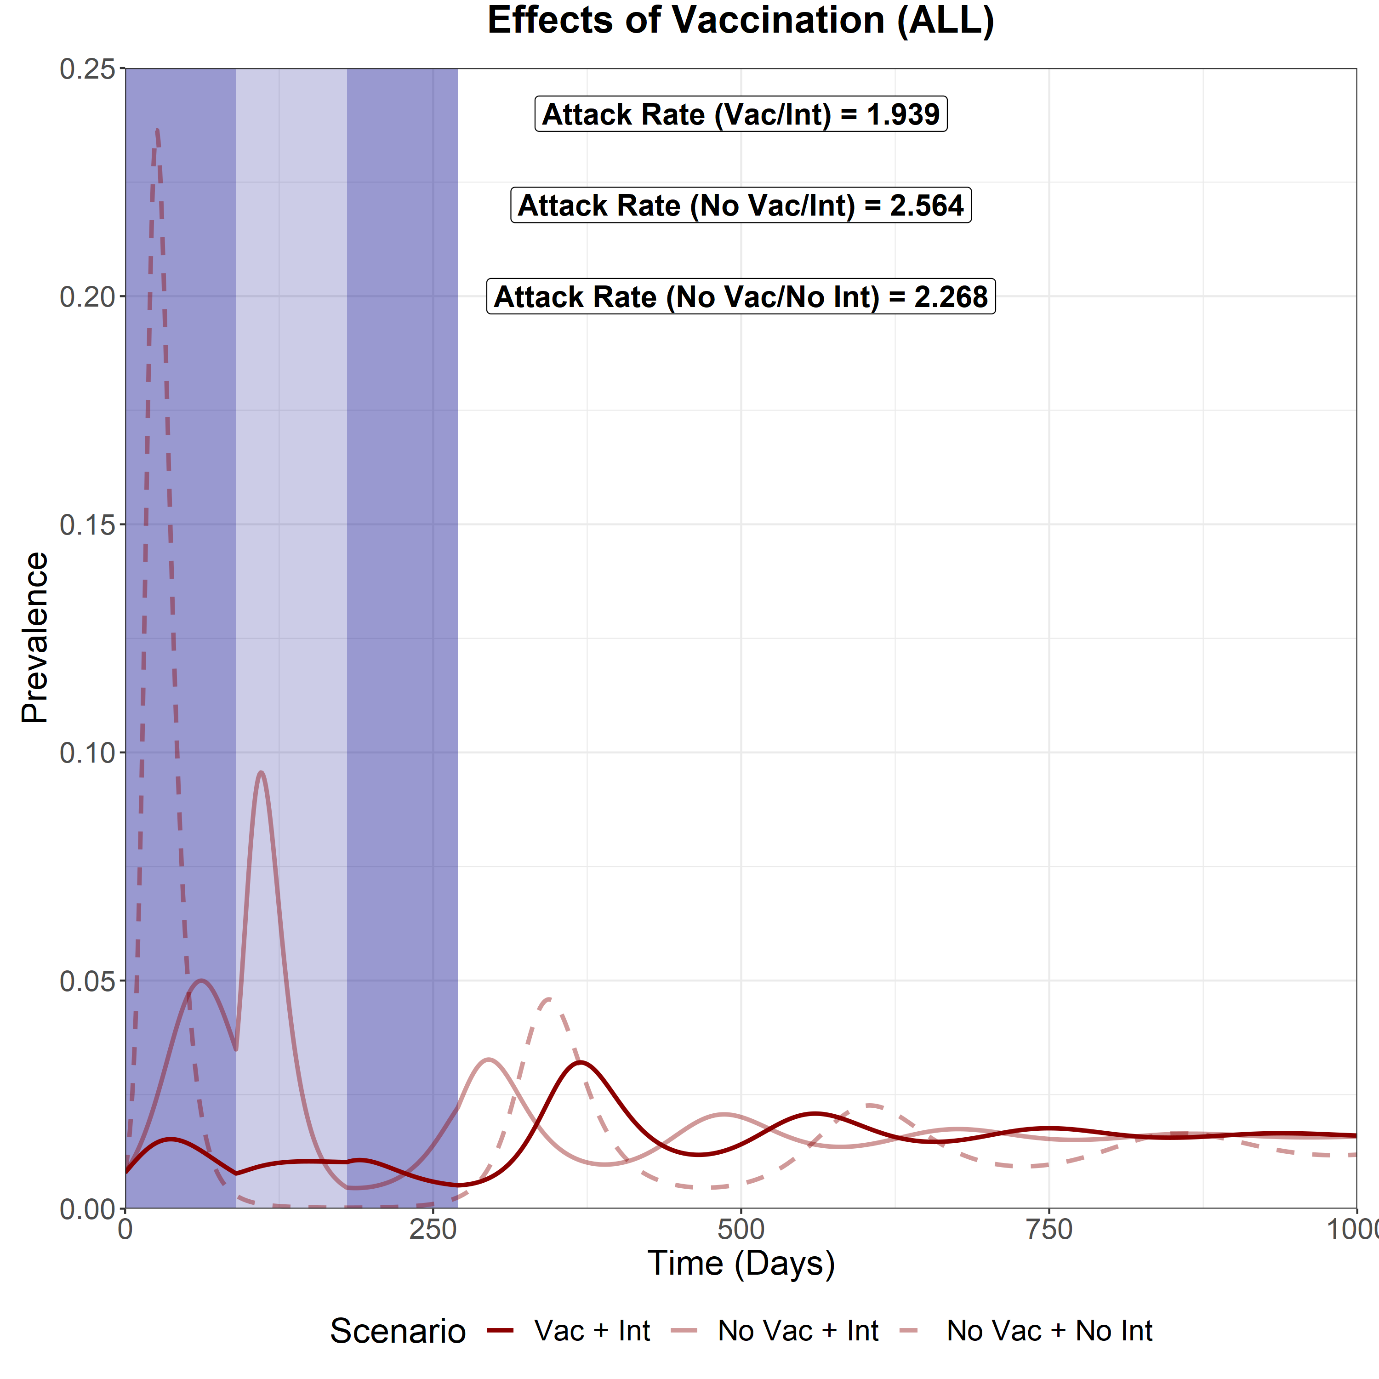
Scenario Analysis (Total Infected)
We now compare the total epidemic curve (the sum of the infectious compartment in each subpopulation) for 3 different scenarios:
With vaccination and sequential intervention release
No vaccination but with sequential intervention release
No vaccination and no interventions
The three shaded areas are the vaccination periods for subpopulation i, j and k respectively.
We can see that by far the greatest impact on reducing the attack rate (cumulative prevalence over the simulated model, t = 365 days) is through the use of sequential vaccination.
Interestingly, the no vac/int attack rate was higher than the no vac/no int attack rate.
This can be observed during the 90-250 day period where prevalence drops to near 0 for the no vac/no int scenario and remains above 0 for the no vac/int scenario. This likely contributed to the higher attack rate

